Slide 1
Fusion of Yoga and AI: A Framework for Emotion and Stress Monitoring
Submitted in the partial fulfillment for the award of the degree of
BACHELOR OF ENGINEERING
IN
CSE-AIML
Submitted by:
Tanisha Nagpal 21BCS5286
Aaditya Singh 21BCS6750
Disha Saini 21BCS6773
Ishaan Shandilya 21BCS6777
Under the Supervision of:
Prof. Dr. Raghav Mehra
Department of AIT-CSE
DISCOVER . LEARN . EMPOWER

Slide 2
Outline
Introduction to Project
Problem Formulation
Objectives of the work
Methodology used
Conclusion
Future Scope
References

Slide 3
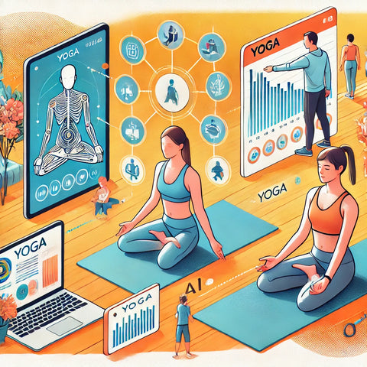
Introduction to Project
The fusion of Yoga and Artificial Intelligence (AI) creates a transformative approach to holistic wellness by integrating ancient practices with modern technology. This project focuses on developing a framework for emotion and stress monitoring using AI-powered tools in combination with yoga. By leveraging wearable devices, machine learning, and real-time feedback mechanisms, the framework aims to provide personalized yoga sessions that address individual emotional and physiological needs. The goal is to enhance mental and physical well-being while making stress management accessible and efficient.

Slide 4
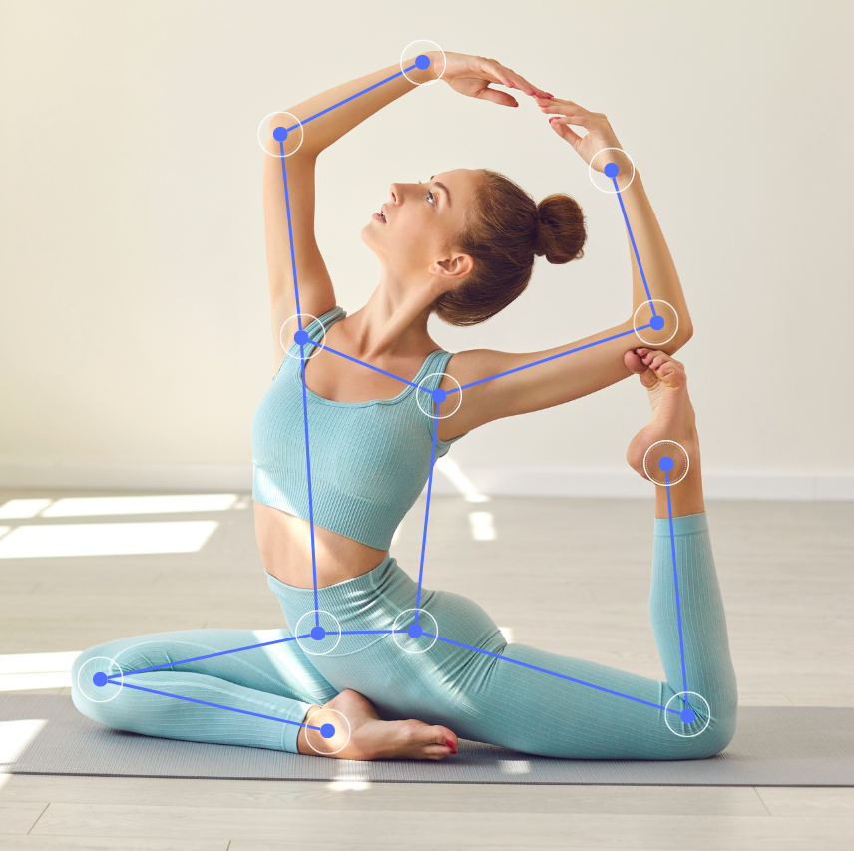
Problem Formulation
In today’s fast-paced world, stress and negative emotions significantly impact mental and physical health. Conventional methods of stress management often lack personalization and real-time feedback. Yoga has proven benefits for stress reduction, but its effectiveness is often limited by the absence of tailored guidance. The challenge lies in creating a system that dynamically adapts yoga practices to an individual’s emotional state and stress level, ensuring a more targeted and impactful approach to wellness.

Slide 5
Objectives of the Work
Develop an AI-based system to monitor emotional states and stress levels using multimodal data from wearables, cameras, and voice inputs.
Design a personalized yoga recommendation engine that tailor’s asanas, pranayama, and meditation practices based on detected emotional and physiological states.
Incorporate real-time feedback mechanisms to improve posture, breathing, and relaxation during yoga sessions.
Track user progress over time and provide actionable insights for long-term emotional and physical well-being.

Slide 6
Methodology used
Data Collection: Gather real-time data on heart rate, HRV, facial expressions, and voice tone using wearables and sensors.
Emotion Detection: Use AI techniques like machine learning and deep learning for emotion and stress analysis.
Personalized Yoga Recommendation: Apply algorithms such as collaborative filtering and reinforcement learning to suggest yoga practices based on user data.
Feedback Mechanism: Integrate computer vision for posture correction and biofeedback for breathing optimization.
Progress Monitoring: Utilize predictive analytics to track user improvements and refine recommendations.

Slide 7
Conclusion
The proposed framework successfully integrates the principles of yoga with advanced AI technologies to create a robust system for emotion and stress monitoring. By providing personalized yoga guidance, real-time feedback, and detailed progress tracking, the framework addresses the limitations of traditional stress management methods. This holistic approach not only enhances mental and physical well-being but also makes yoga more accessible and effective for diverse users.

Slide 8
Future Scope
Expanded Data Sources: Integration with additional sensors for more comprehensive emotion and stress analysis.
AR/VR Integration: Incorporate immersive environments to enhance the yoga experience.
AI Advancement: Use more sophisticated models for improved emotion detection and pose estimation.
Clinical Applications: Extend the framework for therapeutic use in managing anxiety, depression, and other mental health conditions.
Scalability: Develop multi-language and culturally adaptive solutions for global reach.

Slide 9
References
https://doronyoga.com/embracing-the-future-how-ai-is-revolutionizing-yoga-practice/
https://www.researchgate.net/publication/381430708_Yoga_and_Artificial_Intelligence_A_Review_of_The_Potential_Applications_of_AI_in_Yoga_Research_and_Practice_for_Neurological_Disorders

